Slide 1
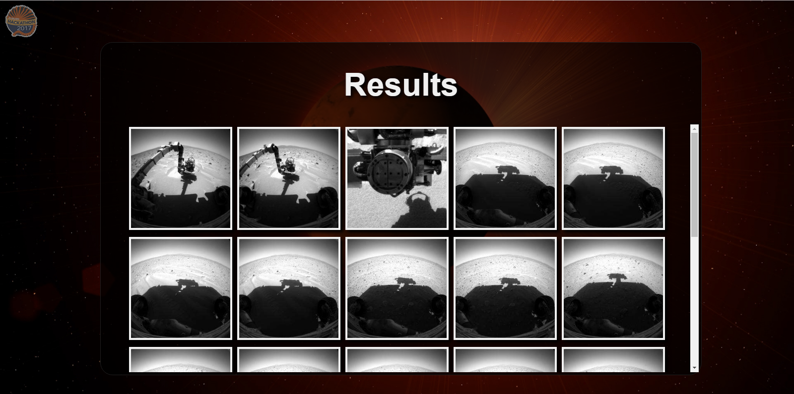
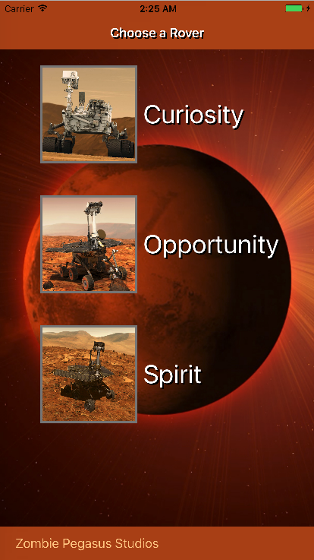
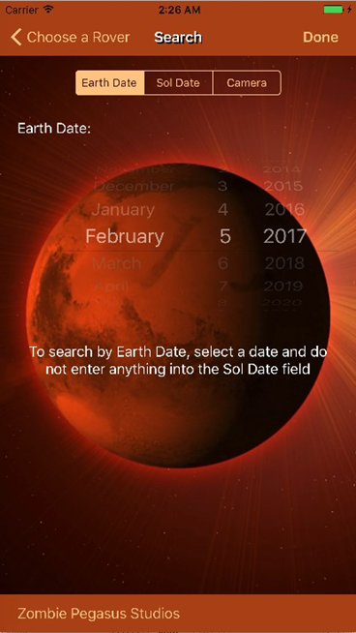
Zombie Pegasus Studios
Frontend website and iOS application that use a shared PHP backend server to allow users to search for images by Martian or Earth date, rover, and camera type.
Kaitlyn Childers, Elijah Holt, and Jeromy Swann

